Slide 1

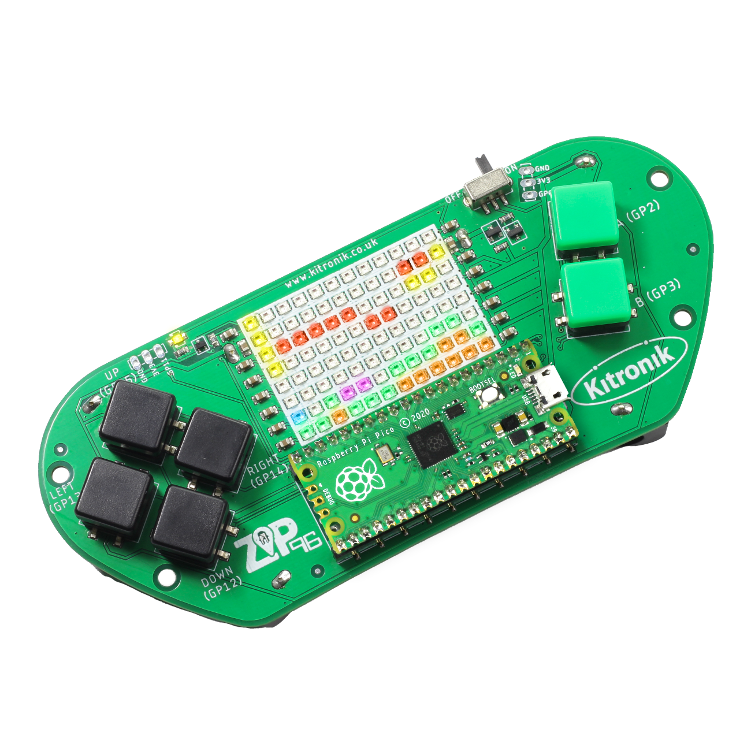
creating the a-mazing game
Computer Science

Slide 2

Aims & objectives
Computer Science
By the end of this lesson you will have:
Written the code to give enemies the functionality to take lives from the player.
Added an end game condition if the player’s lives run out.

Slide 3
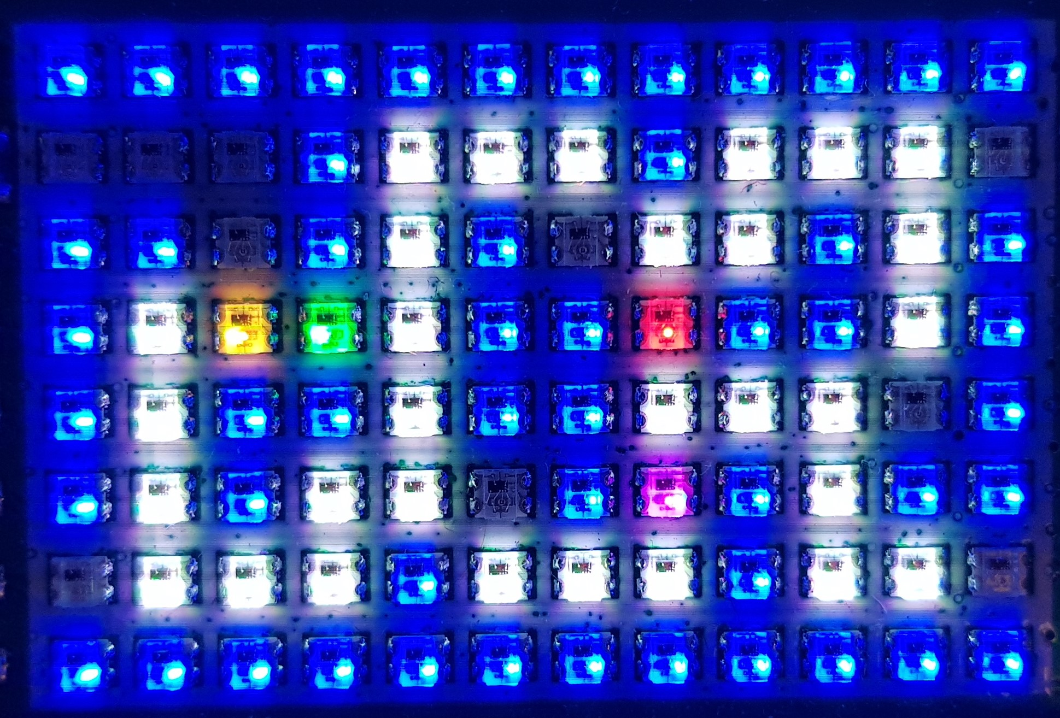
What is our a-mazing game?
Computer Science
A maze-based game where the player runs through a maze collecting gems – collect all the gems to win.
Three different enemies move around the maze as well, trying to stop the player from collecting gems.
One enemy moves randomly, one simply tries to move towards the player, the final one is smart and finds the best path through the maze to the player.
If an enemy catches the player, they lose a life. Once all three lives are lost… game over!

Slide 4
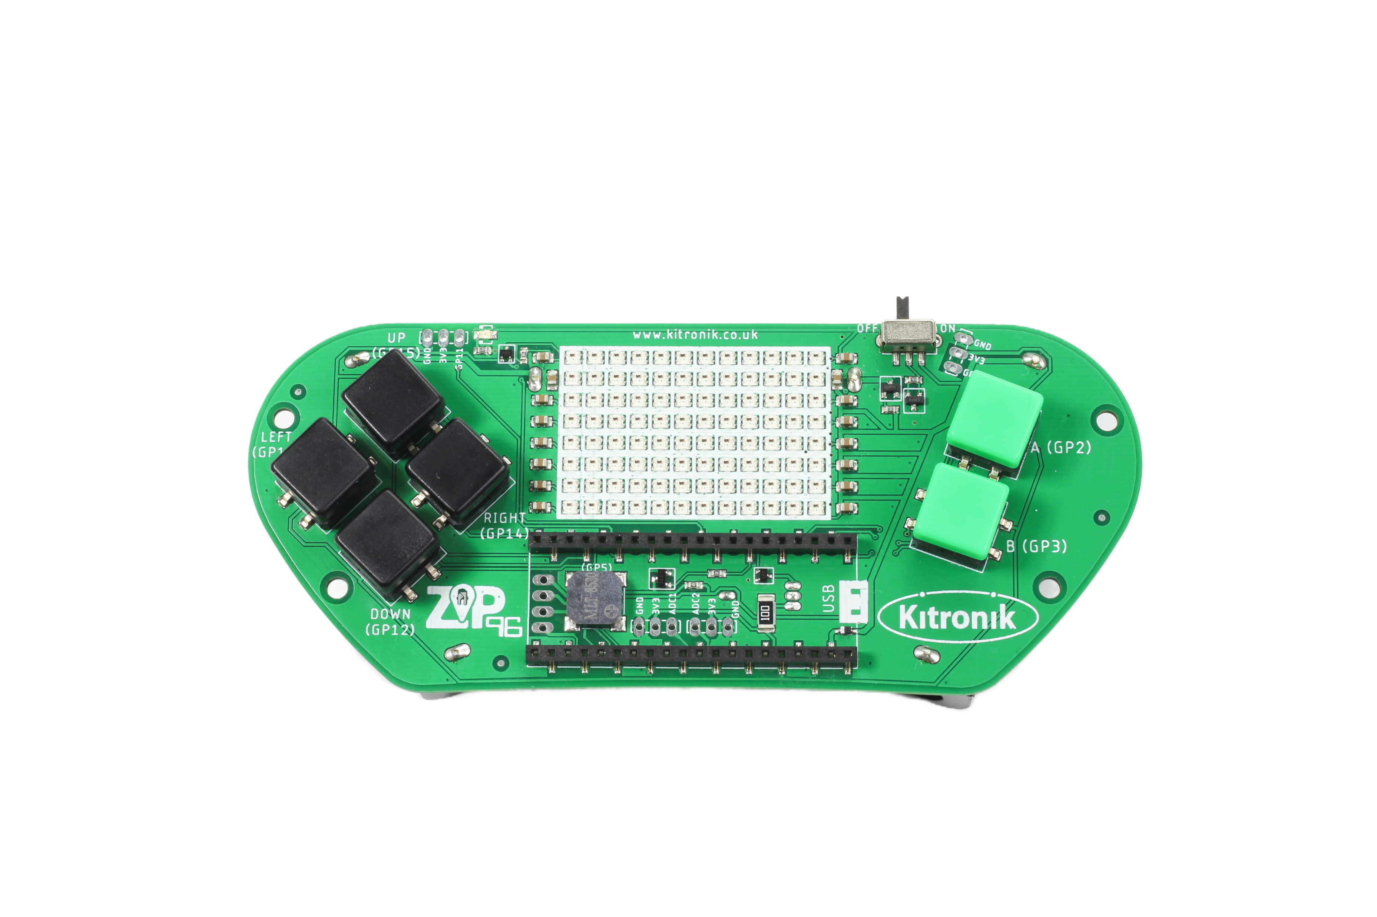
Thonny setup
Computer Science
Connect Pico ZIP96 to computer using a USB cable and open Thonny.

Slide 5
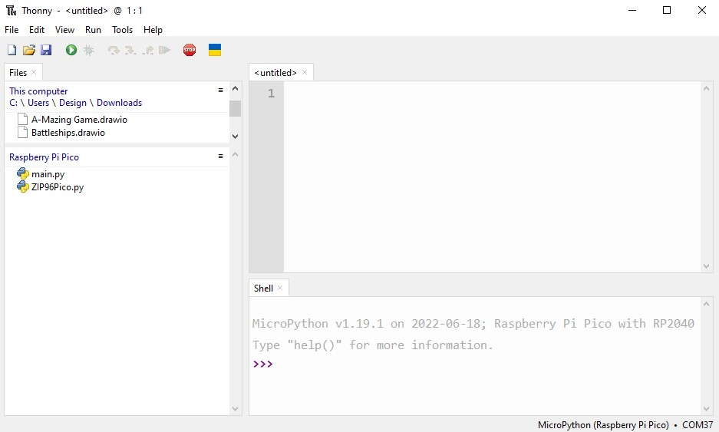
Thonny setup
Computer Science
Check the Pico device appears in the bottom right corner of Thonny.
Try pressing STOP if it does not appear automatically.
Turn on the ‘Shell’ by going to ‘View > Shell’.

Slide 6
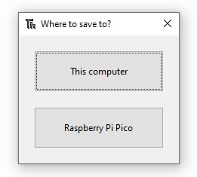
Thonny setup
Computer Science
Create a new file by clicking ‘File > New’.
Save it to the Pico by clicking ‘File > Save as’ and then select ‘Raspberry Pi Pico’.
Name the file ‘main.py’.

Slide 7
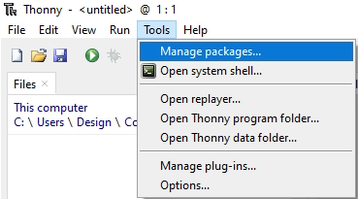
Thonny setup
Computer Science
Install the ‘ZIP96Pico’ library onto the Pico.
Click on ‘Tools > Manage Packages…’

Slide 8
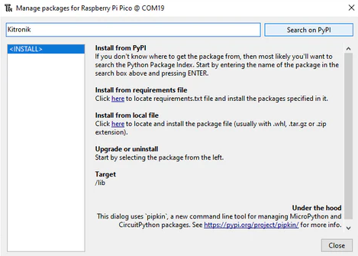
Thonny Setup
Computer Science
With the ‘Manage packages’ window open, search for ‘Kitronik’ and click the ‘Search on PyPI’ button.
Locate ‘KitronikPicoZIP96’ in the list of search results, then click the ‘Install’ button.
Confirm the install by clicking ‘Yes’ if prompted by Thonny.

Slide 9
Coding: player collisions
Computer Science
After the move() function in the Player class, define a new function:
# Check if the given x and y are the same as our current position
def collision(self, x, y):
return self.x == x and self.y == y

Slide 10
Coding: update enemy constructor
Computer Science
In the Enemy constructor, add player parameter and hitPlayer variable:
Adjust the enemies object list to reflect the constructor changes:
# Enemy object constructor
def __init__(self, x, y, colour, walls, gems, player, screen, screenWidth, screenHeight):
self.x = x
self.y = y
self.colour = colour
self.walls = walls
self.gems = gems
self.player = player
self.hitPlayer = False
# List to store our Enemy objects
enemies = [Enemy(6, 2, gamer.Screen.RED, walls, gems, player, screen, screenWidth, screenHeight)]

Slide 11
Coding: enemy / player collisions
Computer Science
At the start of the moveRandom() function in the Enemy class:
At the end of the moveRandom() function in the Enemy class:
self.drawEmpty()
# Reset hitPlayer
self.hitPlayer = False
# If the Enemy is colliding with the Player
if self.player.collision(self.x, self.y):
# Set hitPlayer
self.hitPlayer = True
# Update the new position on the screen
self.draw()

Slide 12
Coding: player & enemy reset
Computer Science
At the end of both the Player and Enemy classes:
# Reset the Player
# position and redraw
def reset(self, x, y):
self.drawEmpty()
self.x = x
self.y = y
self.draw()
# Reset the Enemy
# position and redraw
def reset(self, x, y):
self.drawEmpty()
self.x = x
self.y = y
self.draw()

Slide 13
Coding: updating lives
Computer Science
After the Enemy class, define a new function:
# Update the user and reset the positions
def livesUpdate():
global lives, screen, player, enemies, walls, gems
screen.fill(screen.RED)
screen.show()
sleep(5)

Slide 14
Coding: updating lives continued
Computer Science
After the Enemy class, define a new function:
# If the game isn't over
if lives > 0:
# Reset the screen
screen.fill(screen.BLACK)
# Reset the Player position
player.reset(0, 1)
# Reset the Enemy positions
enemies[0].reset(6, 2)
# Redraw the walls
for wall in walls:
wall.draw()
# Redraw the gems
for gem in gems:
gem.draw()
# Show the updates to the screen
screen.show()

Slide 15
Coding: losing a life
Computer Science
In the main game loop, in the enemy checking loop, add a ‘hit player’ check:
# Check each Enemy in our list
for i in range(len(enemies)):
# First Enemy moves randomly
if i == 0: enemies[i].moveRandom()
# Check if the Enemy has
# collided with our Player
if enemies[i].hitPlayer:
# Remove a life
lives -= 1
# Update the user and
# reset the positions
livesUpdate()
break
Run the program to test whether the player colliding with the enemy shows a red screen, and correctly removes a life

Slide 16
conclusion
Computer Science
In this lesson you have:
Used a for loop, if statement and Boolean logic to check for interaction between Player and Enemy objects.
Updated the user on their progress using the Pico ZIP96 screen.

